Slide 1


The 2024 Seal of Good Local Governance for Barangay
Shared by: CHARISSA DELA TORRE GUERTA
City Director, DILG BUTUAN CITY
Date: October 3, 2024

Slide 2
TOPIC OBJECTIVES:
Gain understanding and appreciation of the Seal of Good Local Governance for Barangay
Familiarize the indicators on Financial Administration and Sustainability
Determine/Identify requirements to comply the Financial Administration and Sustainability indicators in the SGLGB

Slide 3
TOPIC Outline:
Part 1: Seal of Good Local Governance for Barangay: Background and Legal Bases
Part 2: Indicators on Financial Administration and Sustainability (technical notes)

Slide 4
Part 1: The Seal of Good Local Governance for Barangay and its legal bases

Slide 5
WHAT IS SGLGB?
to distinguish barangays with outstanding performance across various governance areas
to encourage barangays to continuously progress in delivering efficient, equitable and quality public services
SGLGB is a performance assessment and recognition system

Slide 6


SGLGB puts primacy to integrity and good performance as pillars of meaningful local autonomy and development

Slide 7
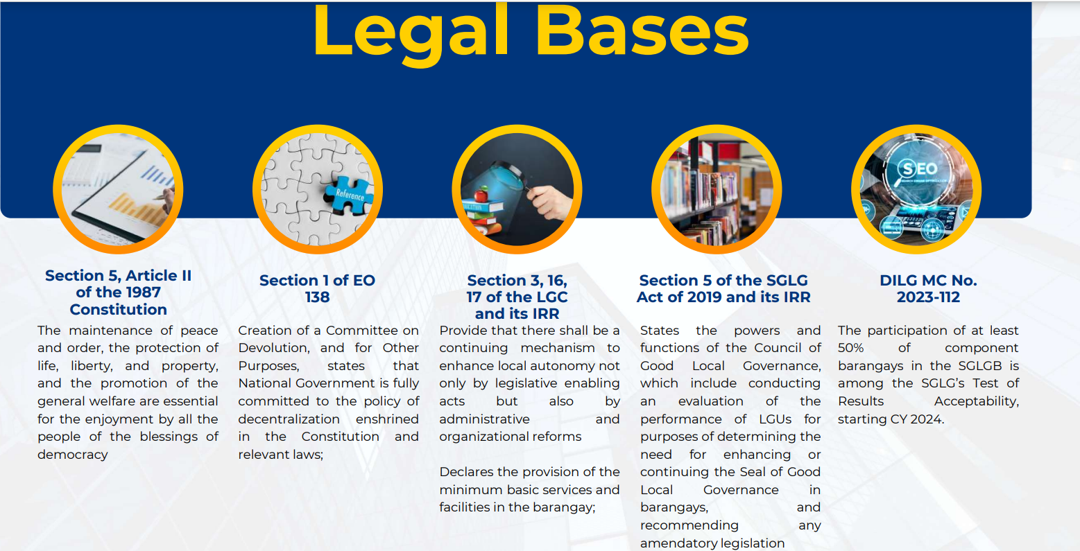

Slide 8
SGLGB Milestones
42,041 – target barangays
2018
Pilot Test
2021
Pilot Test
2023
Roll Out
1,029 barangays assessed
207 (20%) SGLGB passers
1,580 barangays assessed
549 (35%) SGLGB passers
39,623 (94.25%) barangays assessed
1,028 (2.59%) SGLGB passers

Slide 9
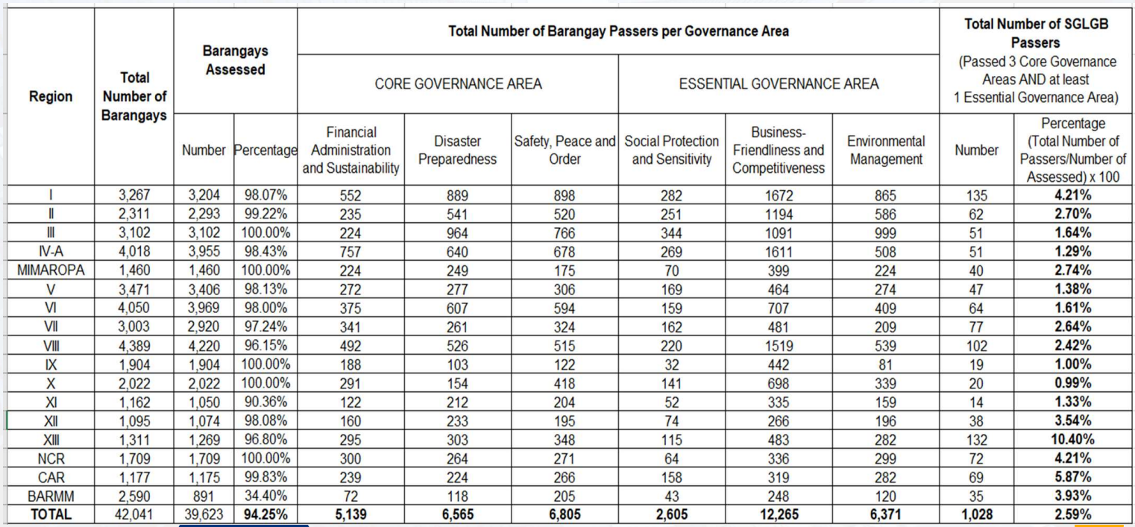
2023 sglgB national consolidated result

Slide 10
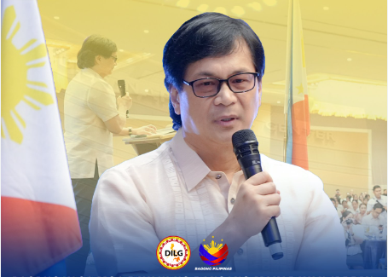
“Congratulations to the 1,028 barangays across the country who responded to the call for excellence in public service and bagged the 2023 SGLGB. Salamat sa pangunguna ninyo sa pagtataas ng antas ng paglilingkod-bayan sa ating mga pamayanan,
“Bahagi na kayo ng kasaysayan ng SGLGB bilang mga kauna-unahang nabigyan ng ganitong pagkilala.”
- Sec. Benjamin “Benhur” Abalos

Slide 11
Purposes of the SGLGB Implementation and Its Results
To assess performance of the barangays and generate information that are useful in policy program development, both at the local and international government levels
To look into the feasibility of the new SGLGB implementation arrangement

Slide 12
Purposes of the SGLGB Implementation and Its Results
To serve as additional information in the regular review and evaluation of the Council of Good Local Governance (CGLG)
To serve as one of the bases in determining capacity development interventions (DILG MC No. 2021-067, “Adoption of a (CAPDEV) Framework in the Planning, Design and Implementation for LGUs”)

Slide 13
Purposes of the SGLGB Implementation and Its Results
To endeavor “ONE AUDIT” for barangays
(in response to the clamor of the DILG field offices and barangays to integrate to the SGLGB the various Barangay-Based Institutions (BBIs) functionality audits)

Slide 14
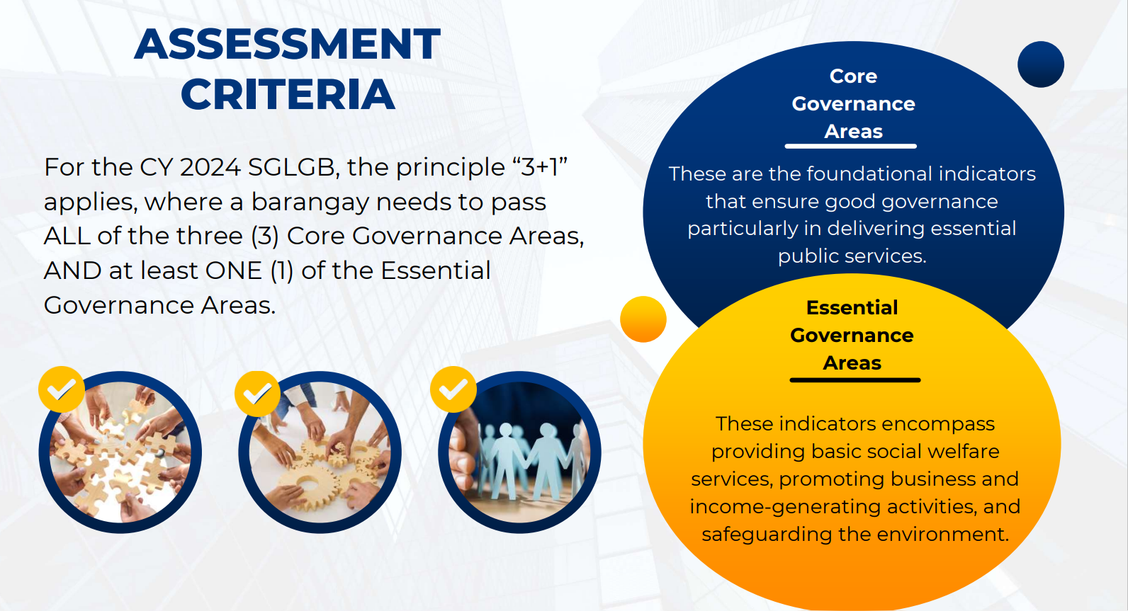

Slide 15






CORE GOVERNANCE AREAS
ESSENTIAL GOVERNANCE AREAS
Financial
Administration and Sustainability
Social
Protection and
Sensitivity
----
-----
Disaster
Preparedness
Business-Friendliness
and Competitiveness
-----
Safety, Peace
and Order
Environmental
Management
15

Slide 16
CORE GOVERNANCE AREAS
Financial
Administration and Sustainability
This pertains to a barangay’s outstanding practice of accountability and transparency in financial administration by adhering with accounting and auditing standards

Slide 17
CORE GOVERNANCE AREAS
Disaster
Preparedness
This refers to a barangay’s proactive measures, including the development and implementation of disaster risk reduction and management program

Slide 18
CORE GOVERNANCE AREAS
Safety, Peace
and Order
This represents a barangay’s outstanding performance in maintaining peace and order through activities and support mechanisms that protect constituents from threats to life, health, and security

Slide 19
ESSENTIAL GOVERNANCE AREAS
Social
Protection and
Sensitivity
----
This encompasses a barangay’s responsiveness to the needs of disadvantaged/challenged sectors and the provision of support for basic education, food security, access to social welfare services, and participation in local special bodies.

Slide 20
ESSENTIAL GOVERNANCE AREAS
Business-Friendliness
and Competitiveness
This reflects a barangay’s notable efforts in promoting business and employment through supportive systems, structures, and legislation.

Slide 21
ESSENTIAL GOVERNANCE AREAS
Environmental
Management
This refers to a barangay’s conscientious preservation of the environment by complying with the provisions of the Ecological Solid Waste Management Act of 2000

Slide 22
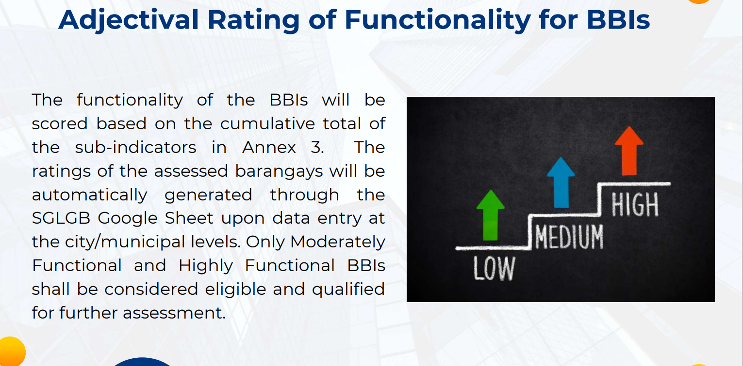

Slide 23
The sglgb LEVEL OF assessment
Ensure data reliability and substantiate assessment observations
Document Review for correctness and initial processing
Document Review for verification and quality check
Evaluation of documents (completeness and appropriateness based indicators)
Barangay Assessment
City/Municipality Assessment
Provincial Assessment
National Assessment
Regional Assessment
Preparation of documents (MOVs)
SGLGB National Working Team
DILG RD / RPAT
National Quality Committee
DILG PD / PPAT
MLGOO/CLGOO/
City Director (HUC)
PB, SB Members

Slide 24
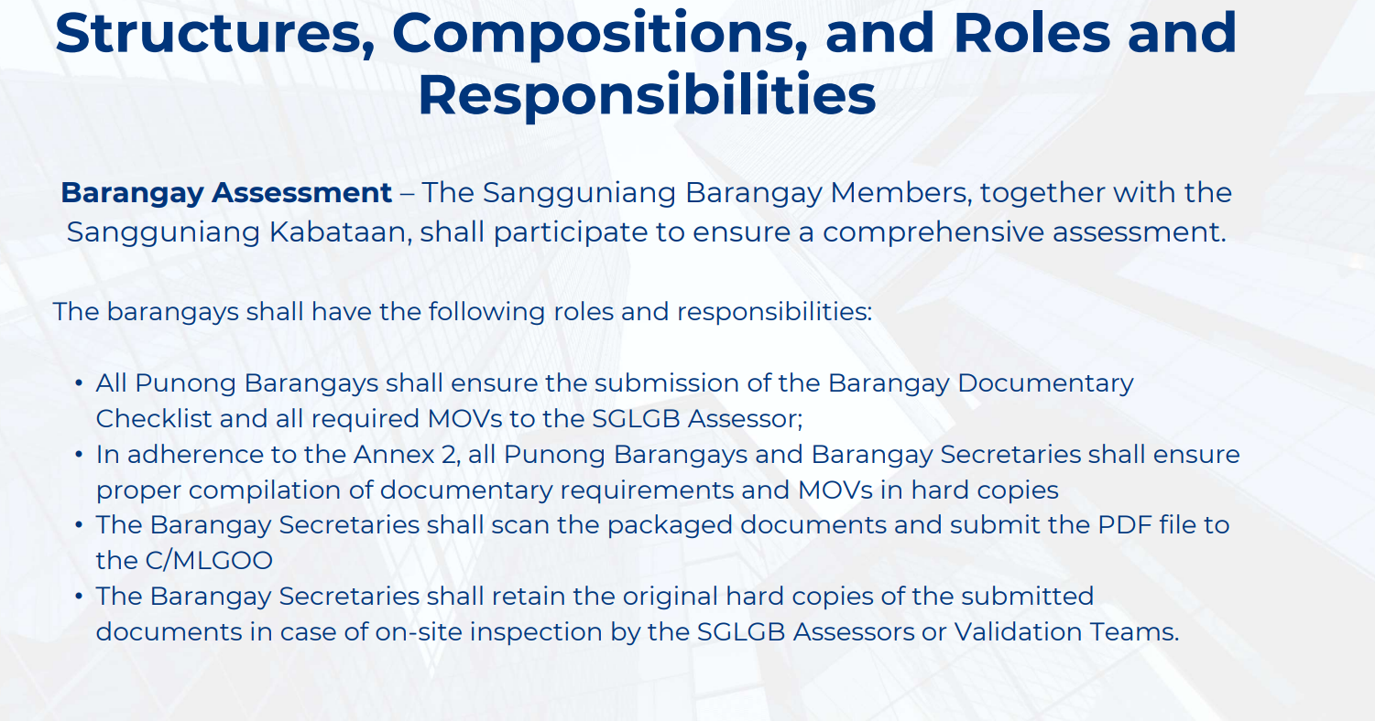
The sglgb assessment

Slide 25
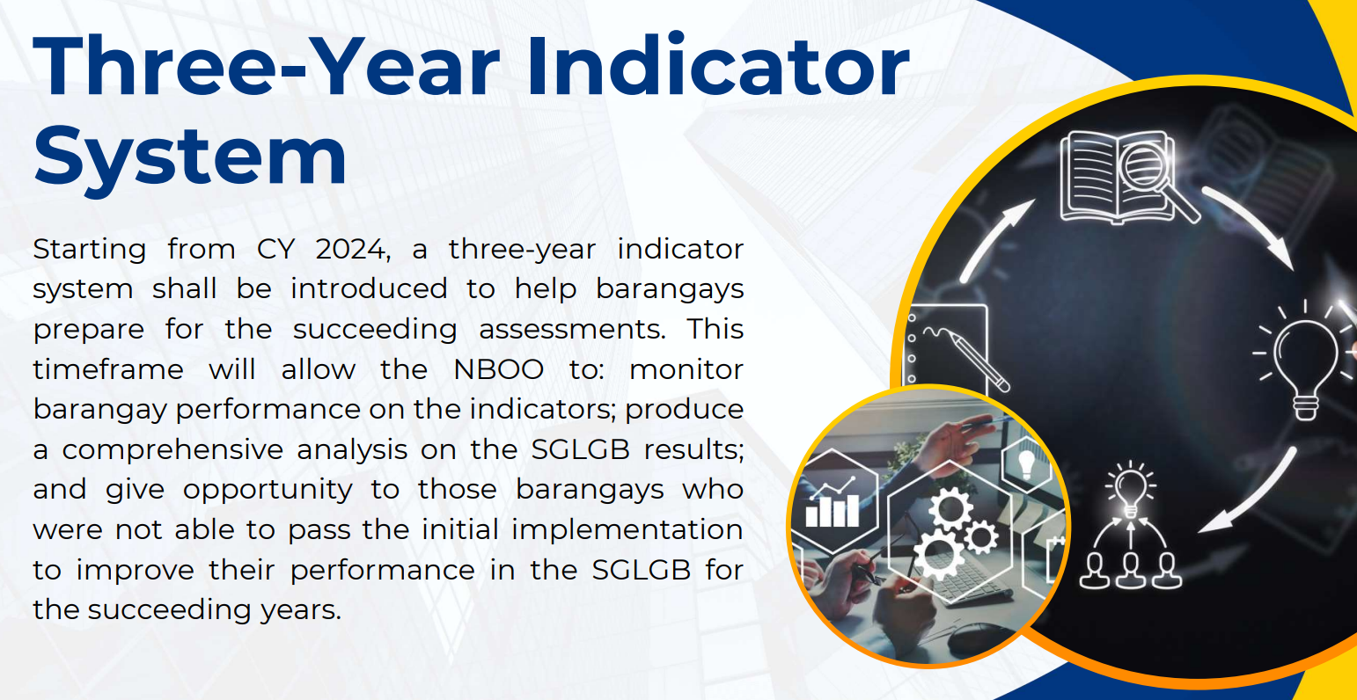

Slide 26
Part 2: INDICATORS ON The FINANCIAL ADMINISTRATION AND SUSTAINABILITY
outstanding practice of accountability and transparency in financial administration by adhering with accounting and auditing standards

Slide 27
Financial Administration and Sustainability: INDICATORS
COMPLIANCE WITH THE BARANGAY FULL DISCLOSURE POLICY (BFDP)
INNOVATIONS ON REVENUE GENERATION OR EXERCISE OF CORPORATE POWERS
APPROVAL OF THE BARANGAY BUDGET ON THE SPECIFIED TIMEFRAME
ALLOCATION FOR STATUTORY PROGRAMS AND PROJECTS AS MANDATED BY LAWS AND/OR OTHER ISSUANCES
POSTING OF THE BARANGAY CITIZEN’S CHARTER (CitCha)
RELEASE OF THE SANGGUNIANG KABATAAN (SK) FUNDS OF THE BARANGAY
CONDUCT OF BARANGAY ASSEMBLY

Slide 28
Indicator 1: COMPLIANCE WITH THE BARANGAY FULL DISCLOSURE POLICY (BFDP)
Relevance/Definition | Minimum Requirements | Documentary Requirements
directive to post in an area inside the barangay hall that can be easily viewed by the public and on their website (if available) Purpose: to demonstrate good financial housekeeping, and to ensure that barangays adhere to the highest ideals and standards of transparency and accountability | 1.1.1 Posted the following CY 2023 financial documents in the BFDP board: Barangay Financial Report Barangay Budget Summary of Income and Expenditures 20% Component of the NTA Utilization | Three (3) BFDP Monitoring Form A (DILG Advisory covering the 1 st to 3 rd quarter monitoring data signed by the City Director/C/MLGOO, Punong Barangay and Barangay Secretary; and

Slide 29
Indicator 1: COMPLIANCE WITH THE BARANGAY FULL DISCLOSURE POLICY (BFDP)
Relevance/Definition | Minimum Requirements | Documentary Requirements
(Section 352 of the Local Government Code of 1991 (R.A. 7160), and DILG Memorandum Circular Nos. 2014-811 and 2022-0272) (The DILG Advisory dated March 25, 2022, “Updated Barangay Full Disclosure Policy (BFDP) Forms/Templates” | e) Annual Procurement Plan or Procurement List f) List of Notices of Award (1st - 3rd Quarter of CY 2023) g) Itemized Monthly Collections and Disbursements (January to September 2023) | 2. Two (2) Photo Documentation of the BFDP board showing the name of the barangay Photo Requirements: One (1) photo with Distant View; and One (1) photo with Close-up View Data Source: Barangay Secretary

Slide 30
Indicator 1: COMPLIANCE WITH THE BARANGAY FULL DISCLOSURE POLICY (BFDP)
Relevance/Definition | Minimum Requirements | Documentary Requirements
Per DBM-DOF-DILG JMC No. 2018-13 , the Barangay Treasurer shall prepare the Barangay Financial Report (BFR) containing the information on the Statement of Receipt and Expenditures (SRE) using the prescribed form. | 1.1.2. Accomplished and signed BFR with received stamp from the Office of the C/M Accountant | Annex B of DBM-DOF-DILG JMC No. 2018-1 Data Source: Barangay Treasurer

Slide 31
Indicator 2: INNOVATIONS ON REVENUE GENERATION OR EXERCISE OF CORPORATE POWERS
Relevance/Definition | Minimum Requirements | Documentary Requirements
Based on Section 152 of the Local Government Code (LGC) of 1991, Barangays may levy taxes, fees, and charges, as provided in the Code, which shall exclusively accrue to them. | 1.2.1 Increase in local resources in CY 2023 | SRE for 2022 and 2023, signed by Barangay Treasurer and Punong Barangay; and Certification on Increase in Local Resources signed by the City/Municipal Treasurer/ Budget Officer Data Source: Barangay Treasurer

Slide 32
Indicator 3: APPROVAL OF THE BARANGAY BUDGET ON THE SPECIFIED TIMEFRAME
Relevance/Definition | Minimum Requirements | Documentary Requirements
Budget authorization is the process of adopting and enacting the annual Barangay Budget into an Appropriation Ordinance pursuant to Section 391(a)(3) of the LGC , which provides that “the Sangguniang Barangay shall enact annual and supplemental budgets in accordance with the provisions of this Code”. | 1.3.1 Presence of a Barangay Appropriation Ordinance approved on or before December 31, 2022 Consideration: Approval until March 31, 2023. | Approved Barangay Appropriation Ordinance signed by the Sangguniang Barangay Members (SBMs), SK Chairperson, Barangay Secretary, and Punong Barangay Data Source: Barangay Secretary

Slide 33
Indicator 4: ALLOCATION FOR STATUTORY PROGRAMS AND PROJECTS AS MANDATED BY LAWS AND/OR OTHER ISSUANCES
Relevance/Definition | Minimum Requirements | Documentary Requirements
DBM-LBM No. 854 defines allocations for statutory programs and projects (as the budgeted resources designated for initiatives mandated by legislation or other official pronouncements. | 1.4.1 With allocated funds for the following statutory programs and projects: At least 20% of the NTA is allocated for development programs; Not less than five percent (5%) shall be set aside as the Local Disaster Risk Reduction and Management Fund; | Approved Barangay Appropriation Ordinance; Annual Investment Program signed by Barangay Treasurer, Barangay Secretary, and Punong Barangay; and

Slide 34
Indicator 4: ALLOCATION FOR STATUTORY PROGRAMS AND PROJECTS AS MANDATED BY LAWS AND/OR OTHER ISSUANCES
Relevance/Definition | Minimum Requirements | Documentary Requirements
Moreover, it emphasizes that priority allocation for the National Tax Allotment (NTA) and other local resources must be directed towards fulfilling the obligations outlined in Section 17(b) of the LGC. These obligations encompass providing essential services and facilities to the local community. | c) Gender and Development; d) Senior Citizens and Persons with Disabilities; e) Implementation of the programs of the Local Councils for the Protection of Children; and f) Ten percent (10%) for the Sangguniang Kabataan | 3. Certification for the Allocation for Statutory Programs and Projects signed by the City/Municipal Budget Officer

Slide 35
Indicator 5: POSTING OF THE BARANGAY CITIZEN’S CHARTER (CitCha)
Relevance/Definition | Minimum Requirements | Documentary Requirements
Pursuant to Section 6 of Republic Act (RA) No. 94855 as amended by RA No. 110326 , all government agencies, including departments, … and local government units (LGUs) shall set up their respective most current and updated service standards to be known as the Citizen’s Charter. | 1.5.1 Barangay Citizens’ Charter posted at a conspicuous place (e.g. barangay hall, market, transport terminal, or multi-purpose hall) | Two (2) Photo documentation of the Barangay CitCha (name of the barangay should be visible) Photo Requirements: One (1) photo with Distant View; and One (1) photo with Close-up View Data Source: Barangay Secretary

Slide 36
Indicator 6: RELEASE OF THE SK FUNDS OF THE BARANGAY
Relevance/Definition | Minimum Requirements | Documentary Requirements
“All the income of the barangay derived from whatever source shall accrue to its general fund and shall, at the option of the barangay concerned, be kept as a trust fund in the custody of the city or municipal treasurer or be deposited in a bank, preferably government-owned, situated in or nearest to its area of jurisdiction” (Section 20 (a) of the SK Reform Act of 2015) | 1.6.1 Compliance with Section 20 of the SK Reform Act of 2015 and Item 3.2 of DBM-DILG-NYC JMC No. 1, s. 2019 dated January 23, 2019 1.6.1.1. The barangay has Barangay-SK Agreement for the release/deposit; | MOVs for 1.6.1.1: 1. Copy of the written agreement; and 2. Proof of deposit reflecting the Account No./ Name of Barangay SK and the total allocated amount for the 2023 SK funds

Slide 37
Indicator 6: RELEASE OF THE SK FUNDS OF THE BARANGAY
Relevance/Definition | Minimum Requirements | Documentary Requirements
It mandates that 10% of the general fund of the barangay shall be set aside for the SK. The Sangguniang Barangay shall appropriate the SK funds in lump-sum which shall be disbursed solely for youth development and empowerment purposes. SK have financial independence in its operation, disbursement of their fund, income, and expenditure. (Section 20 (b))

Slide 38
Indicator 6: RELEASE OF THE SK FUNDS OF THE BARANGAY
Relevance/Definition | Minimum Requirements | Documentary Requirements
Item 3.2.1 of the DBM-DILG-NYC JMC No. 1, s. 20197 dated January 23, 2019 provides that the SK funds shall be automatically released by the barangay to the SK and shall not be subject to any lien or holdback that may be imposed by the barangay for whatever purpose. | 1.6.1.2. The barangay does not have Barangay-SK Agreement but with current account; | MOV for 1.6.1.2: Deposit slips reflecting the Account No./ Name of Barangay SK and the total allocated amount for the 2023 SK funds Consideration: (In the absence of deposit slips, bank statements will be considered, provided that it shows the transaction date, and that the total 10% of the SK Fund has been transferred.)

Slide 39
Indicator 6: RELEASE OF THE SK FUNDS OF THE BARANGAY
Relevance/Definition | Minimum Requirements | Documentary Requirements
3.2.2 of the same JMC states that the SK shall open a current account in the name of the SK in a bank, preferably government-owned, situated in or nearest to its area of jurisdiction, with the SK chairperson and the SK treasurer as the official signatories | 1.6.1.3. The barangay does not have SK Officials or with SK Officials but no quorum and/or No SK Bank Account | MOV for 1.6.1.3: 1. Proof of transfer of the 10% 2023 SK funds to the trust fund of the Barangay such as Deposit Slip or Official Receipt; OR

Slide 40
Indicator 6: RELEASE OF THE SK FUNDS OF THE BARANGAY
Relevance/Definition | Minimum Requirements | Documentary Requirements
Item 3.2.3 of the same JMC mandates that the SK funds shall be deposited by the barangay in the current account of the SK not later than 5 WD after crediting of the monthly NTA share of the barangay. The barangay may opt to transfer/release the SK funds earlier than herein prescribed on an annual, semestral or quarterly basis, subject to the written agreement between the barangay and the SK. | Note: SK Resolution authorizing the barangay to utilize the SK Funds if the SK has no bank account yet shall not be considered as MOV under the indicator. | MOV for 1.6.1.3: (b) Proof of transfer or corresponding legal forms/documents issued by the city/municipal treasurer if the barangay opted that the corresponding SK fund be kept as trust fund in the custody of the C/M treasurer.

Slide 41
Indicator 6: RELEASE OF THE SK FUNDS OF THE BARANGAY
Relevance/Definition | Minimum Requirements | Documentary Requirements
Item 3.2.4 provides that in case of barangays without elected SK officials, the barangay shall transfer the corresponding ten percent (10%) SK Fund to the trust fund of the barangay, and the same shall be released by the barangay upon the election of the SK officials concerned.

Slide 42
Indicator 6: RELEASE OF THE SK FUNDS OF THE BARANGAY
Relevance/Definition | Minimum Requirements | Documentary Requirements
Item 3.3.1.2 of the DBM-DILG-NYC JMC No. 1, s. 2019 dated January 23, 2019 states that the Comprehensive Barangay Youth Development Plan (CBYDP) shall serve as the basis for the preparation of the Annual Barangay Youth Investment Program (ABYIP). | 1.6.2 Presence of Approved Annual Barangay Youth Investment Program (ABYIP) for 2023 | If the barangay has 5 and above SK Officials: Approved Resolution approving the 2023 SK Annual/Supplemental Budget; and An Approved 2023 ABYIP signed by the SK Chairperson and its members

Slide 43
Indicator 6: RELEASE OF THE SK FUNDS OF THE BARANGAY
Relevance/Definition | Minimum Requirements | Documentary Requirements
The ABYIP shall contain the specific programs, projects, and activities with corresponding project costs, including the necessary fund flows to approximate the reasonable timing in the release of funds. It is understood that the ABYIP shall reflect the total resource requirement for the budget year Item 3.3.1.3 of the same JMC also states that the ABYIP shall be prepared and approved by the SK through a resolution before the start of the preparation of the SK annual budget. |  | If the barangay has 4 and below SK Officials: Certification from the C/MLGOO on THE number of SK officials

Slide 44
Indicator 7: CONDUCT OF BARANGAY ASSEMBLY
Relevance/Definition | Minimum Requirements | Documentary Requirements
Section 397 (b) of R.A. No. 7160 mandates that the barangay Assembly shall meet at least twice a year to hear and discuss the semestral report of the barangay concerning its activities and finances as well as problems affecting the barangay. Proclamation No. 599 series of 2018 dated October 9, 2018 declares the Saturdays and Sundays of March and October as barangay assembly days. | 1.7.1 Conducted the 1st semester Barangay Assembly for CY 2023 | Post Activity Report/ Minutes on the conduct of the 1 st semester Barangay Assembly 2023 duly approved by the Punong Barangay

Slide 45
END OF PRESENTATION!

